Slide 1
Hello new s1’s!!
By “A S1 Springburn Academy pupil”

Slide 2
School stuff
First thing you need is school things like for example: a bag, pencils, rubber, pens, note pad for some notes.
So be prepared! Be organised!

Slide 3
Now houses.
There are houses that you will be put into. So if you have any older siblings you will be put in the same house for example, you have an older sister and she is in Burns, then you will be in Burns.
So the houses are: Burns, Clyde, Rowling, and last but not least Wallace.

Slide 4
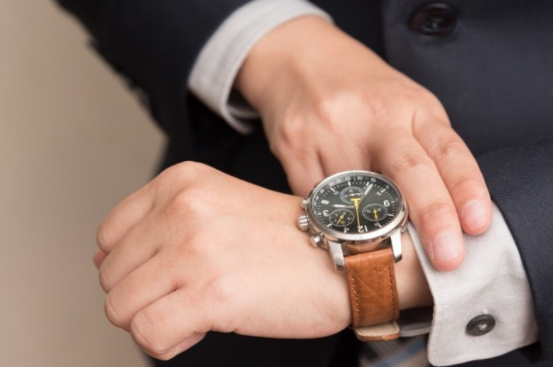
Classes.
So your first period will start at 8:50.
I know it’s earlier than normal at primary but we need a lot of education!
You will get a timetable with you classes for everyday.

Slide 5
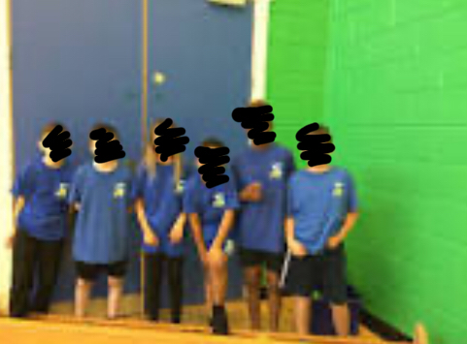
School rules!
For the rules there is nothing that is scary. It’s just things you’re not allowed to do in class, like no food or juice in class, no phones in class or you’ll get it taken off you. You need to have the correct school uniform, including your p.e kit!

Slide 6
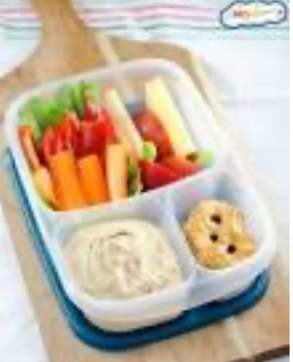
Break/lunch.
No S1 pupils are not allowed to go down to the shopping centre. When you are S2 you can go down at lunchtime.
So don’t try ☺
And try to eat healthily!

Slide 7
Merits!
So merits are like a point you get given in class when you do something good. You need a lot to go on rewards trips and stuff. You will even get a certificate!
It’s a good moment to have.

Slide 8
Last information.
That’s all I guess. Just try hard, work hard and get close to your goals!

